Slide 1
Chapter 2
Neuroanatomy and Brain Mapping

Slide 2
Anatomical terms of location
Dorsal – literally back side: refers to the top
Ventral – literally stomach side: refers to the bottom
Medial – towards to middle
Lateral – away from the middle
Anterior – literally before: towards the front
Posterior – literally after: towards the back

Slide 3
Brodmann areas
A BA is a region of the cerebral cortex
Based on its cytoarchitecture or organization of cells
Korbinian Brodmann

Slide 4
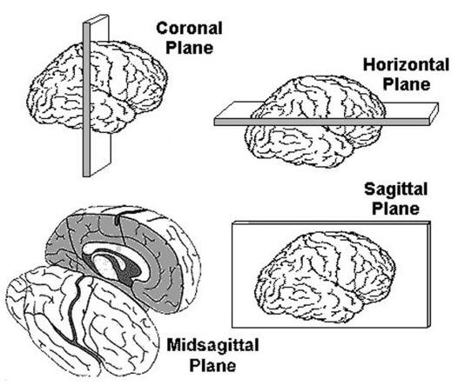
Planes of section
Transverse
perpendicular to neuraxis
Sagittal
sideways
Horizontal
down from the top

Slide 5
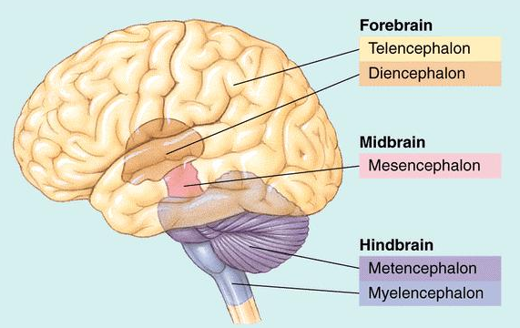
Major divisions in human brain

Slide 6
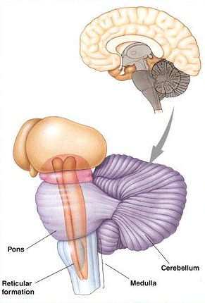
Hindbrain
Myelencephalon
Medulla oblongata
respiration, muscle tone
Metencephalon
Cerebellum
Smooth muscle action
Pons
Sleep and arousal

Slide 7
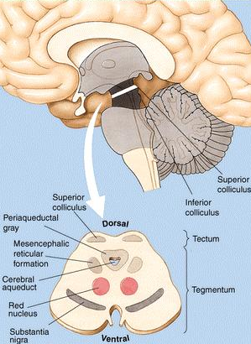
Midbrain
Tectum
Superior colliculi – visual
Inferior colliculi – auditory
Tegmentum
Periaqueductal gray – pain and defensive behaviour
Red nucleus – motor
Reticular formation – arousal
Substantia nigra – motor – (Parkinson’s disease)

Slide 8
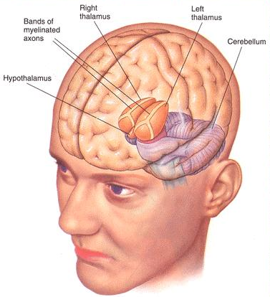
Forebrain: Diencephalon
Thalamus
One in each hemisphere
Contains sensory relay
Hypothalamus
ANS control
Homeostatasis
Fighting, feeding, fleeing, sexual behaviour

Slide 9
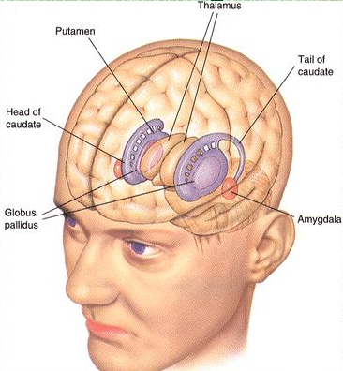
Forebrain: Telencephalon
Striatum
Caudate
Putamen
Globas pallidus
Function
Motor
Cognitive – attention?

Slide 10
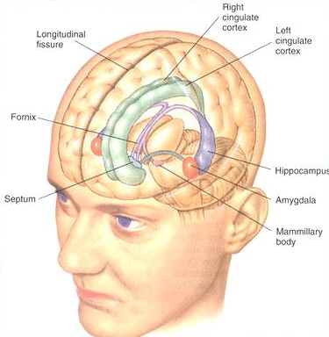
Forebrain: Telencephalon
Limbic system – poorly defined
Hippocampus & mammillary bodies
Memory
Amygdala
Emotion anxiety/fear

Slide 11
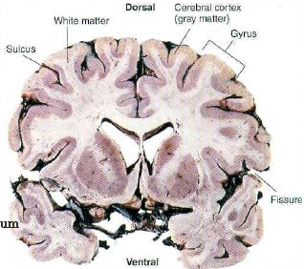
Forebrain: Neocortex
White matter
Fibre tracts
Grey matter
Cortex
Cell bodies
Gyri (humps)
Sulci (valleys)
Fissures (big valleys)

Slide 12
Six layer cortex
Six separate and identifiable layers
Molecular layer
External granular layer
External pyramidal layer
Internal granular layer
Internal pyramidal layer
Multiform layer

Slide 13
Lobes of the brain

Slide 14
Occipital lobe
At posterior end of cortex
Receives input from visual pathways
Most posterior part is ‘primary visual cortex’ or ‘striate cortex’
Damage to V1 (striate cortex) causes loss of vision or ‘cortical blindness’
Extrastriate areas are distinct for different visual tasks, such as colour processing (V4) and motion perception (V5)

Slide 15
Parietal lobe
Lies between occipital lobe and central sulcus
Specialized for dealing with spatial awareness and navigation
When the parietal lobe suffers injury, most especially on the right side, the individual can experience hemispatial neglect

Slide 16
Temporal lobe
Located laterally on each hemisphere under the lateral or Sylvian fissure
Left temporal lobe seemingly specialized for human speech
Also contributes to complex aspects of vision (e.g. face perception)
Also plays part in motivational and emotional behaviours

Slide 17
Frontal lobe
Found anterior to the parietal lobe and dorsal to the temporal lobe is the frontal lobe
Deals with complex processes including planning, coordinating, controlling and carrying out behaviour
The primary motor cortex is located in the frontal lobe and is responsible for the control of the voluntary movements
Located in the left frontal lobe is Broca’s area
Anterior part – prefrontal cortex – receives information from all sensory systems

Slide 18
Ventricular system
Hollow structures in the brain that are joined to the spinal cord's central canal
Four ventricles
right & left lateral ventricles
third ventricle
fourth ventricle

Slide 19
Brain mapping techniques

Slide 20
How to study a brain
Ex-vivo
Post-mortem (i.e. dead body)
Ex-vitro
Slices, cultures
In-vivo
Whole animal
Invasive
Non-invasive

Slide 21
Ex-vivo (post-mortem)
Non-dynamic
Macroscopic and microscopic observation of tissue
Staining of tissue to show structures or chemistry
Biochemical analysis of tissue

Slide 22
In-vivo
Biochemical analysis of dynamic processes
Electrophysiology recording of neural activity
Effects of drugs, changed chemical environment, electrical stimulation

Slide 23
In-vivo (animal studies)
Induced lesion
Aspiration
Electrical
Chemical
Stimulation
Electrical
Chemical
Micro recording
Single-unit
Multi-unit
Genetic engineering
Knockouts
Replacement

Slide 24
Animal lesions
Give cognitive tasks to animals
Damage part of animal’s brain
See if animal can still perform or learn task
If not, then damaged brain part must play role in cognitive operation required for the task

Slide 25
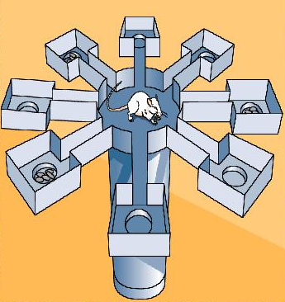
An example: Radial arm maze
Place animal in maze
Only some arms contain reward
After repeated trials animal goes to baited arms, not empty ones
Cognitive operations
spatial navigation
spatial learning

Slide 26
Stereotaxic surgery
If you want to lesion a very small or sub-cortical area, you have to be able to locate the area
Location of areas of the brain is done in stereotaxic space

Slide 27
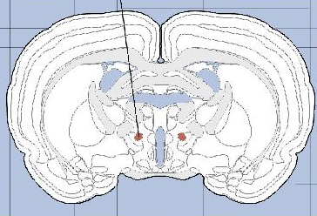
Stereotaxic atlas
Any given part of the brain will have coordinates in stereotaxic space and those coordintes can be located in an atlas

Slide 28
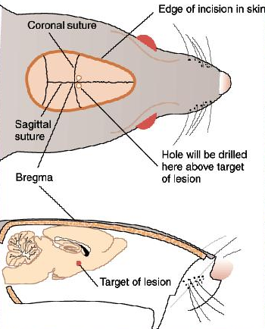
Stereotaxic landmark is the bregma
The bregma is where the coronal and the sagittal sutures of the skull intersect

Slide 29
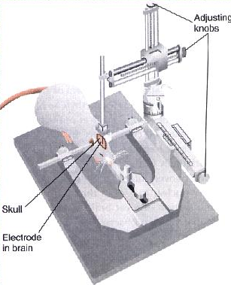
Stereotaxic device
Animal anaesthetized
Head fixed in device
Bregma is exposed
Electrode is guided in brain area with adjustment knobs
Current is applied to electrode lesioning area

Slide 30
EEG and ERP
Electroencephalography (EEG)
Electrical field of brain
Records potential of neurons doing same thing at same time
Event-related potential (ERP)
Changes in the electrical fields related to a stimulus or an action
Averaged EEG signal
Inverse problem with localization because of unknowns in brain structure

Slide 31
Magnetoencephalogram (MEG)
There is a magnetic field perpendicular to the electric field
Magnetic field not attenuated by the skull
Very small magnetic fields
Inverse problem reduced

Slide 32
CT or CAT scan
Computed Axial Tomography
Basically, a fancy X-ray with some computer reconstruction
Requires radiation exposure

Slide 33
Structural MRI
Magnetic Resonance Imaging
Detect hydrogen density
Hydrogen density is dependent upon water content
Different tissues have different water content
MRI provides near-photographic detail with no radiation

Slide 34
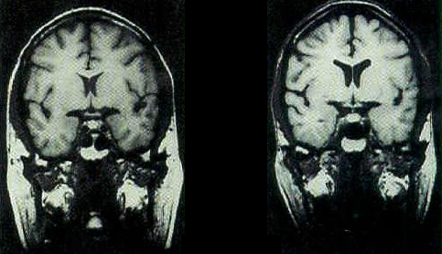
Structural data alone
Enlarged ventricles shows tissue loss in identical twins discordant for schizophrenia

Slide 35
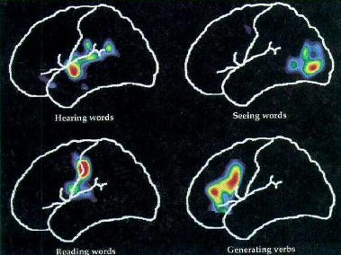
Positron Emission Tomography (PET)
Uses radioactive tracer
Metabolic activity is measured as a indirect measure of the radioactive tracer

Slide 36
Functional MRI (fMRI)
Oxygen and glucose are carried by the blood
Parts of the brain that are active in a given task will require more fuel
Blood-oxygen-level dependent (BOLD) contrast
Measures changes in blood flow, therefore called ‘hemodynamic’

Slide 37
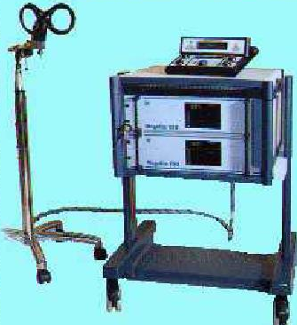
Transcranial Magnetic Stimulation (TMS)
A magnetic field induces an electrical current in a nearby conductor
A magnetic pulse in a coil induces a brief electrical current in the nearby brain area
This transiently disrupts functioning in the brain area below

Slide 38
Cerebral dialysis
Measures the concentration of specific neurochemicals outside the cells in behaving animals
Fine microdialysis probe consists of a metal tube with a artificial semi-permeable membrane at the bottom

Slide 39
2-deoxyglucose method
Animal is injected with radioactive 2-deoxyglucose
Placed in a situation that will activate a particular behaviour
Slices of the brain are then examined at post-mortem under autoradiography

Slide 40
In-vivo voltammetry
Measurement of the extracellular concentration of neurochemicals in behaving animals
Monitor changes in the flow of current as the voltage across a carbon-based electrode rises
There are chemicals in the nervous system that are oxidized at different intensities and are thus identifiable

Slide 41
Behavioural genetic techniques
Study of the influence of heredity and environment
Nature versus nurture
Twin studies
Adoption studies

Slide 42
Neuropsychological techniques
Measurement of psychological function attributed to a specific brain structure or pathway
Psychometric theory – comparison against norms from large population
Used in rehabilitation and assessment
Cognitive functions such as attention, executive function, working memory

Slide 43
Brain structure

Slide 44
Research techniques

Slide 45
Readings
Barnes, J. (2011). Essential Biological Psychology (Chapter 2). London: Sage.
The Essentials
Diamond, M.C., Scheibel, A.B., & Elson, L.M. (1985). The Human Brain Coloring Book (Coloring Concepts Series). New York: HarperCollins.
Next Steps
Stewart, L., Ellison, A., Walsh, V., & Cowey, A. (2001). The role of transcranial magnetic stimulation (TMS) in studies of vision, attention and cognition. Acta Psychologica (Amst), 107(1-3), 275-291.
Delving Deeper
Plomin, R., DeFries, J.C., McClearn, G.E., & Rutter, M. (1997). Behavioral Genetics (3rd edn). New York: Freeman.

